Slide 1


ICAgile
Advanced Kubernetes
ICP – K8S
Agile Brains Consulting, Inc.
ICP-IDO
Agile Brains Consulting
1
©Agile Brains Consulting Inc. All rights reserved. Not to be reproduced without prior written consent.

Slide 2
Welcome: ICAgile – Advanced Kubernetes
Logistics
Ground Rules
Introduction
Name / Role / Company / DevOps Experience / Fun Fact(s)
Expectations
Agile Brains Consulting
2
©Agile Brains Consulting Inc. All rights reserved. Not to be reproduced without prior written consent.

Slide 3
Chapter 1: Docker – Refresher
Agile Brains Consulting
3
©Agile Brains Consulting Inc. All rights reserved. Not to be reproduced without prior written consent.

Slide 4
1.1 Introduction to containers and Docker
Agile Brains Consulting
4
©Agile Brains Consulting Inc. All rights reserved. Not to be reproduced without prior written consent.

Slide 5

Docker Basics
Docker Image
The basis of a Docker container
Docker Container
The standard unit in which the application service resides
Docker Engine
Creates, ships and runs Docker containers deployable on physical or virtual host locally, in a datacenter or cloud service provider
Docker Registry
On-premises registry for image storing and collaboration
Agile Brains Consulting
5
©Agile Brains Consulting Inc. All rights reserved. Not to be reproduced without prior written consent.

Slide 6
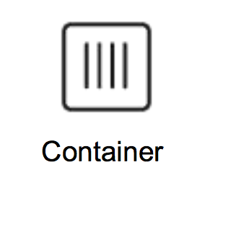
Containers as a Solution
Packages up software binaries and dependencies
Isolates software from each other
Container is a standard format
Easily portable across environment
Allows ecosystem to develop around its standard
Agile Brains Consulting
6
©Agile Brains Consulting Inc. All rights reserved. Not to be reproduced without prior written consent.

Slide 7
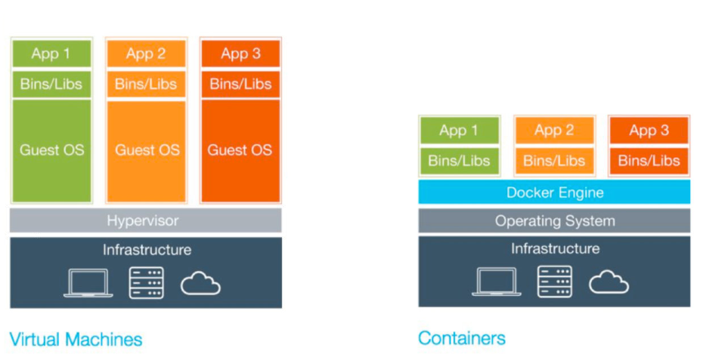
VMs vs Containers
Agile Brains Consulting
7
©Agile Brains Consulting Inc. All rights reserved. Not to be reproduced without prior written consent.

Slide 8
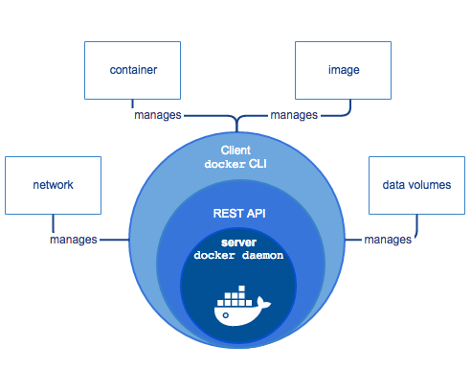
Components of Docker
Agile Brains Consulting
8
©Agile Brains Consulting Inc. All rights reserved. Not to be reproduced without prior written consent.

Slide 9
Components of Docker
The Docker daemon (dockerd) listens for Docker API requests and manages Docker objects such as images, containers, networks, and volumes. A daemon can also communicate with other daemons to manage Docker services.
A Docker registry stores Docker images. Docker Hub and Docker Cloud are public registries that anyone can use, and Docker is configured to look for images on Docker Hub by default. You can even run your own private registry.
The Docker client (docker) is the primary way that many Docker users interact with Docker. When you use commands such as docker run, the client sends these commands to dockerd, which carries them out. The docker command uses the Docker API. The Docker client can communicate with more than one daemon.
Agile Brains Consulting
9
©Agile Brains Consulting Inc. All rights reserved. Not to be reproduced without prior written consent.

Slide 10
Installing Docker on Linux
There is a Docker-maintained community script that will install the latest release on your Linux machine (most popular flavors) available at https://get.docker.com/
Run ‘curl -sSL https://get.docker.com/ | sh’ in your terminal
The script will also install a Union File System driver and verify Docker engine functionality
Agile Brains Consulting
10
©Agile Brains Consulting Inc. All rights reserved. Not to be reproduced without prior written consent.

Slide 11
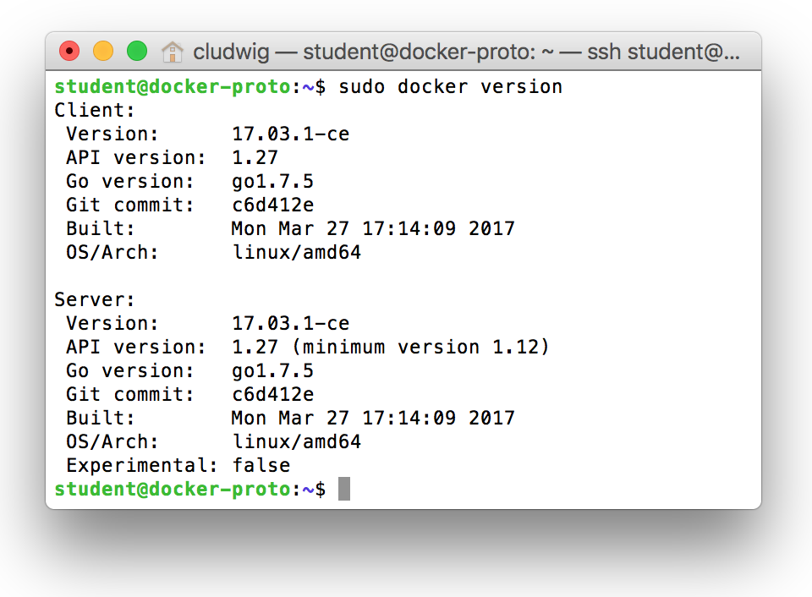
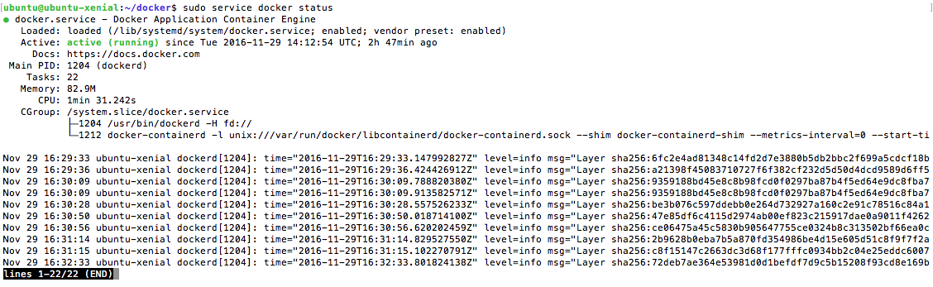
Check Docker Installation
$ sudo docker version
$ sudo service docker status
Agile Brains Consulting
11
©Agile Brains Consulting Inc. All rights reserved. Not to be reproduced without prior written consent.

Slide 12
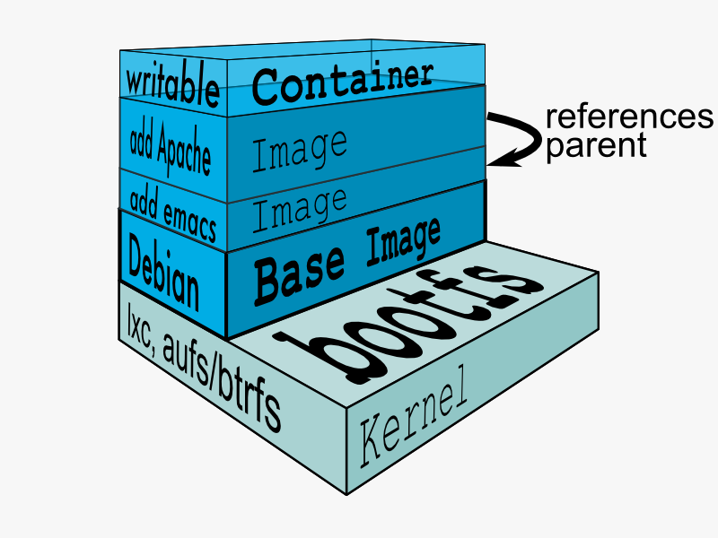
Docker Union File System
AuFS (AnotherUnionFS) is a multi-layered filesystem that implements union mount
Allows several filesystems or directories to be simultaneously mounted and visible through a single mount point
Appears to be one filesystem to the end user
Agile Brains Consulting
12
©Agile Brains Consulting Inc. All rights reserved. Not to be reproduced without prior written consent.

Slide 13
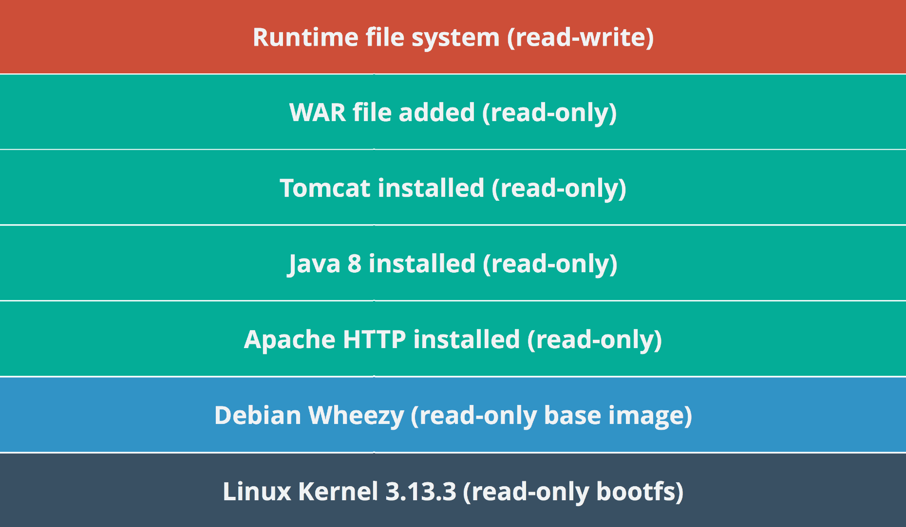
Example Docker Layers
Docker Layer – Each Docker image is composed of a series of layers. Docker uses Union File Systems to combine these into a single image. The combination of these layers gives the illusion of a traditional file system. Only the top layer is writeable.
Agile Brains Consulting
13
©Agile Brains Consulting Inc. All rights reserved. Not to be reproduced without prior written consent.

Slide 14
Docker Hub
Docker’s first-party cloud-based registry
Hosts a broad repository of Docker images
Contains nearly any popular open source technology
Contains ‘Official images’ from vendors such as Canonical, Oracle, Red Hat, etc
Provides one free private Docker repo, more for a paid subscription
hub.docker.com
Agile Brains Consulting
14
©Agile Brains Consulting Inc. All rights reserved. Not to be reproduced without prior written consent.

Slide 15
Docker Private Registry
The Registry is a stateless, highly scalable server side application that stores and lets you distribute Docker images.
Private registries are registries that are hosted and managed by third party or the organization itself (not by Docker).
Agile Brains Consulting
15
©Agile Brains Consulting Inc. All rights reserved. Not to be reproduced without prior written consent.

Slide 16
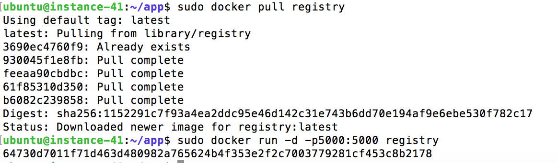
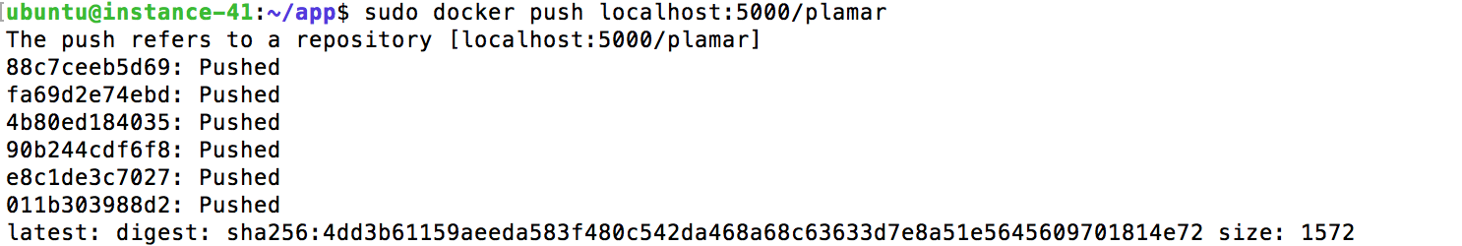
Running a Private Docker Registry
docker run -d -p5000:5000 registry
docker push localhost:5000/<id>
https://github.com/docker/docker.github.io/blob/master/registry/deploying.md
Agile Brains Consulting
16
©Agile Brains Consulting Inc. All rights reserved. Not to be reproduced without prior written consent.

Slide 17
Docker Registry Search
Search Registry
https://docs.docker.com/registry/spec/api/#listing-repositories
List Image Tags
https://docs.docker.com/registry/spec/api/#listing-image-tags
Agile Brains Consulting
17
©Agile Brains Consulting Inc. All rights reserved. Not to be reproduced without prior written consent.

Slide 18
Docker – Run Containers
Tells docker to run a cmd in container
Cmd to run inside
container
docker run docker/whalesay cowsay Hello World
Base image for
container
Argument to
Cowsay cmd
Agile Brains Consulting
18
©Agile Brains Consulting Inc. All rights reserved. Not to be reproduced without prior written consent.

Slide 19
Docker – Other useful commands
docker run -i -t <image> # interactive mode
docker attach <container> # attach a process id to a container
docker exec -it <container> /bin/bash # execute a cmd in container from host
docker ps # list running containers
docker ps -a # list all containers
docker images # list all image
docker stats # provide cpu, memory, etc. for containers
docker pull # pull image from a repo
docker inspect <container>|<image> # inspect an image or a container
docker history <image> # check layers of an image
docker container|image prune -f # remove unused containers or images
Agile Brains Consulting
19
©Agile Brains Consulting Inc. All rights reserved. Not to be reproduced without prior written consent.

Slide 20
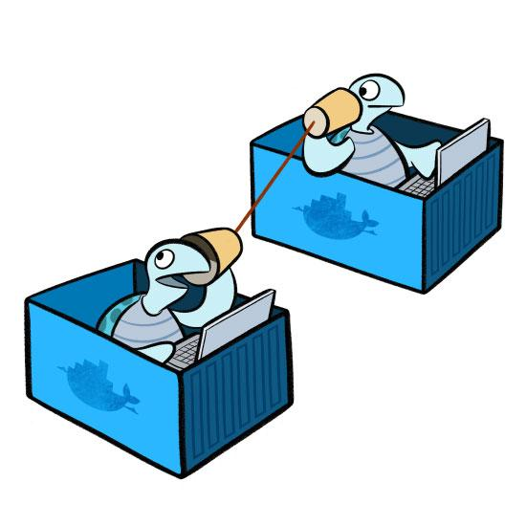
Docker Networking
Agile Brains Consulting
20
©Agile Brains Consulting Inc. All rights reserved. Not to be reproduced without prior written consent.

Slide 21
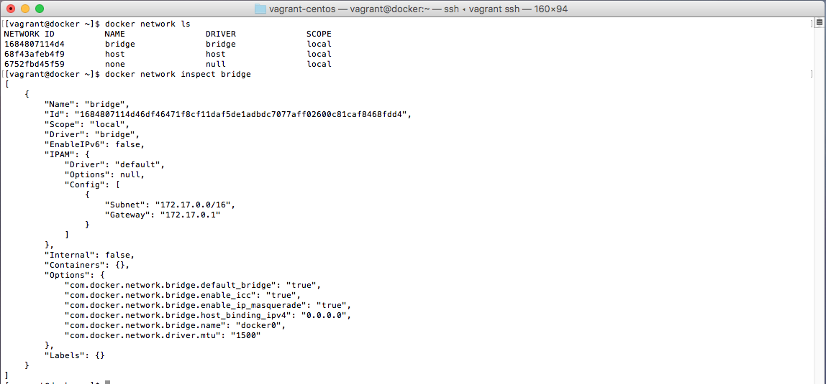
Docker Networking Defaults
Three networks are created by default (bridge, host & none)
docker network ls
We can easily inspect the bridge network
docker network inspect bridge
We see that a 172.17.0.0/16 address space is allocated. Created Containers are given an IP in this space by default.
Agile Brains Consulting
21
©Agile Brains Consulting Inc. All rights reserved. Not to be reproduced without prior written consent.

Slide 22
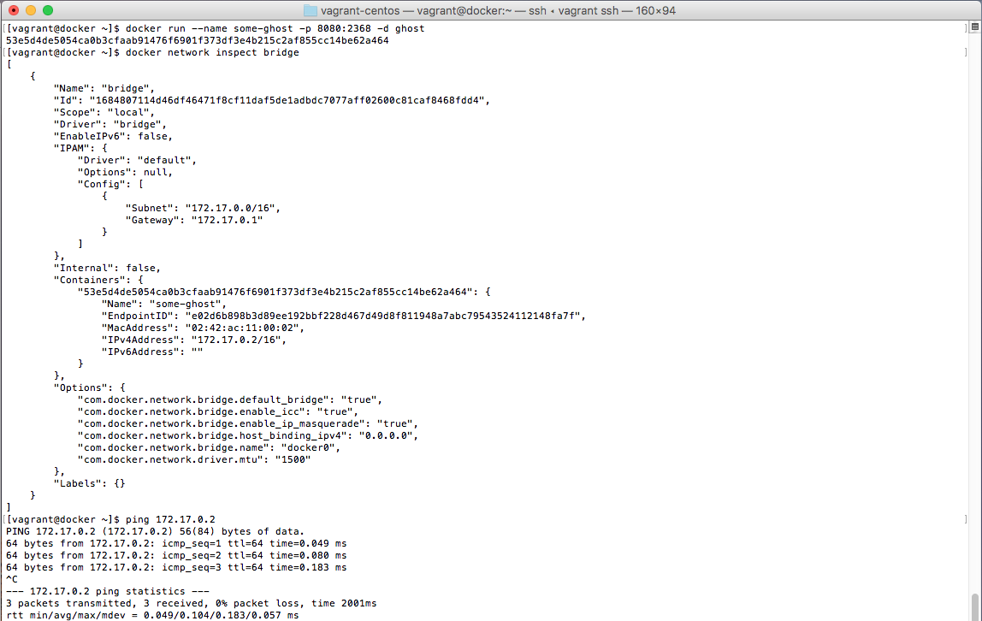
Docker Networking Defaults
Created container is attached to bridge network by default
Can be attached to user created networks as well with --network flag
Container is assigned 172.17.0.2 ip in the bridge network and appears in the docker inspect command
The container can then be pinged at 172.17.0.2
Agile Brains Consulting
22
©Agile Brains Consulting Inc. All rights reserved. Not to be reproduced without prior written consent.

Slide 23
Docker Networking Commands
Command | Description
docker network create | Create a network
docker network ls | List networks
docker network inspect | Detailed information on network
docker network rm | Remove network
docker network disconnect | Disconnect container from network
docker network connect | Connect container to network
Agile Brains Consulting
23
©Agile Brains Consulting Inc. All rights reserved. Not to be reproduced without prior written consent.

Slide 24
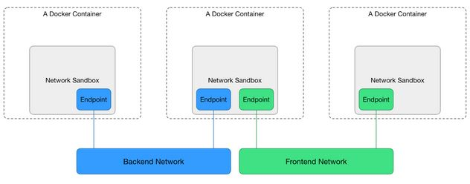
Isolated User Networks
The bridge network is useful in a development environment
Production environments usually require more security and isolated or more customized networking solutions.
Agile Brains Consulting
24
©Agile Brains Consulting Inc. All rights reserved. Not to be reproduced without prior written consent.

Slide 25
Docker Networking – Lab
https://github.com/shekhar2010us/kubernetes_teach_git/blob/master/docker_networking/docker_networking_lab.md
Agile Brains Consulting
25
©Agile Brains Consulting Inc. All rights reserved. Not to be reproduced without prior written consent.

Slide 26
What is docker0 bridge?
Docker0 bridge is the bridge network named bridge created automatically when you install Docker.
By default, the Docker server creates and configures the host system’s docker0 a network interface called docker0, which is an ethernet bridge device. If you don’t specify a different network when starting a container, the container is connected to the bridge and all traffic coming from and going to the container flows over the bridge to the Docker daemon, which handles routing on behalf of the container.
Agile Brains Consulting
26
©Agile Brains Consulting Inc. All rights reserved. Not to be reproduced without prior written consent.

Slide 27
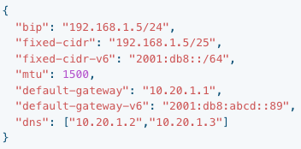
Customize docker0 bridge
You can configure the default bridge network’s settings using flags to the dockerd command. However, the recommended way to configure the Docker daemon is to use the daemon.json file, which is located in /etc/docker/ on Linux
Restart Docker after making changes to the daemon.json file
--bip=CIDR: supply a specific IP address and netmask for the docker0 bridge, using standard CIDR notation.
--fixed-cidr=CIDR and --fixed-cidr-v6=CIDRv6: restrict the IP range from the docker0 subnet, using standard CIDR notation.
--mtu=BYTES: override the maximum packet length on docker0.
--default-gateway=Container default Gateway IPV4 address and --default-gateway-v6=Container default gateway IPV6 address: designates the default gateway for containers connected to the docker0 bridge, which controls where they route traffic by default.
--dns=[]: The DNS servers to use
Agile Brains Consulting
27
©Agile Brains Consulting Inc. All rights reserved. Not to be reproduced without prior written consent.

Slide 28
Docker Interaction with IPTables
On Linux, Docker manipulates iptables rules to provide network isolation.
All of Docker’s iptables rules are added to the DOCKER chain. Do not manipulate this table manually. If you need to add rules which load before Docker’s rules, add them to the DOCKER-USER chain. These rules are loaded before any rules Docker creates automatically
To restrict connection to Docker daemon
By default, all external source IPs are allowed to connect to the Docker daemon.
To allow only a specific IP or network to access the containers, insert a negated rule at the top of the DOCKER filter chain.
Agile Brains Consulting
28
©Agile Brains Consulting Inc. All rights reserved. Not to be reproduced without prior written consent.

Slide 29
Control Docker with IPTables
To restrict access to all external IPs except a single IP:
iptables -I DOCKER-USER -i ext_if ! -s 192.168.1.1 -j DROP
To only allow access to connection from a subnet:
iptables -I DOCKER-USER -i ext_if ! -s 192.168.1.0/24 -j DROP
To specify a range of IP addresses to accept:
iptables -I DOCKER-USER -m iprange -i ext_if ! --src-range 192.168.1.1-192.168.1.3 -j DROP
Agile Brains Consulting
29
©Agile Brains Consulting Inc. All rights reserved. Not to be reproduced without prior written consent.

Slide 30
Docker Volumes
Agile Brains Consulting
30
©Agile Brains Consulting Inc. All rights reserved. Not to be reproduced without prior written consent.

Slide 31
Volume Persistence
Docker –v flag can mount the volume to a specific directory
Volumes can be mounted using absolute path or specified “Docker Volumes” which resides in /var/lib/docker/…
source
destination
docker run -d -P --name web -v /src/webapp:/webapp training/webapp python app.py
Agile Brains Consulting
31
©Agile Brains Consulting Inc. All rights reserved. Not to be reproduced without prior written consent.

Slide 32
Docker Volume Commands
Command | Description
docker volume create | Create a volume
docker volume ls | List volumes
docker volume inspect | Detailed information on volume
docker volume rm | Remove volume
Agile Brains Consulting
32
©Agile Brains Consulting Inc. All rights reserved. Not to be reproduced without prior written consent.

Slide 33
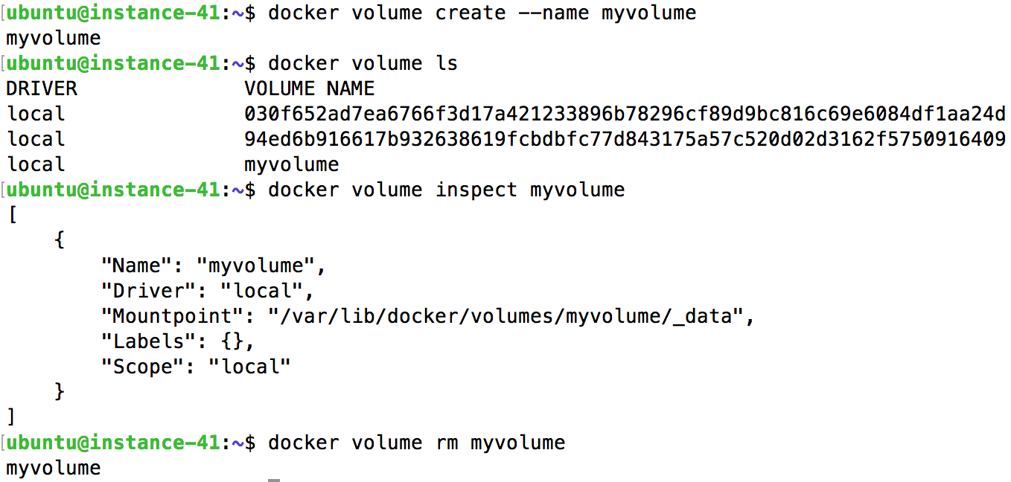
Working with Volumes
Agile Brains Consulting
33
©Agile Brains Consulting Inc. All rights reserved. Not to be reproduced without prior written consent.

Slide 34
Dangling Volumes
If container is deleted with a volume attached, the volume remains. Sometimes removing all such ‘dangling’ volumes is desired
$ docker volume prune
Agile Brains Consulting
34
©Agile Brains Consulting Inc. All rights reserved. Not to be reproduced without prior written consent.

Slide 35
Docker Daemon Logging
Agile Brains Consulting
35
©Agile Brains Consulting Inc. All rights reserved. Not to be reproduced without prior written consent.

Slide 36
Docker Daemon Logging
Docker includes multiple logging mechanisms to help you get information from running containers and services. These mechanisms are called logging drivers.
Each Docker daemon has a default logging driver, which each container uses unless you configure it to use a different logging driver.
To configure the Docker daemon to default to a specific logging driver, set the value of log-driver to the name of the logging driver in the daemon.json file, which is located in /etc/docker/ on Linux hosts
Agile Brains Consulting
36
©Agile Brains Consulting Inc. All rights reserved. Not to be reproduced without prior written consent.

Slide 37
Docker Daemon Logging
The daemon logs may help you diagnose problems. The logs may be saved in one of a few locations:
Operating System | Location
RHEL, Oracle Linux | /var/log/messages
Debian | /var/log/daemon.log
Ubuntu 16.04+, CentOS | Use the command journalctl -u docker.service
Ubuntu 14.10- | /var/log/upstart/docker.log
macOS (Docker 18.01+) | ~/Library/Containers/com.docker.docker/Data/vms/0/console-ring
macOS (Docker <18.01) | ~/Library/Containers/com.docker.docker/Data/com.docker.driver.amd64-linux/console-ring
Windows | AppData\Local
Agile Brains Consulting
37
©Agile Brains Consulting Inc. All rights reserved. Not to be reproduced without prior written consent.

Slide 38
Docker Daemon Logging
To enable debugging, the recommended approach is to set the debug key to true in the daemon.json file, which is usually located in /etc/docker/
On macOS or Windows, do not edit the file directly. Instead, go to Preferences / Daemon / Advanced.
{ "log-driver": "json-file", or syslog
"log-opts": {
"max-size": "10m",
"max-file": "3",
"labels": "production_status",
"env": "os,customer”
}
}
Change log driver to syslog
Agile Brains Consulting
38
©Agile Brains Consulting Inc. All rights reserved. Not to be reproduced without prior written consent.

Slide 39
Container Logging
To find the current default logging driver for the Docker daemon:
docker info --format '{{.LoggingDriver}}’
When you start a container, you can configure it to use a different logging driver than the Docker daemon’s default:
docker run -it --log-driver <driver> <image> <params>
Agile Brains Consulting
39
©Agile Brains Consulting Inc. All rights reserved. Not to be reproduced without prior written consent.

Slide 40
Container Logging – Lab
https://github.com/shekhar2010us/kubernetes_teach_git/tree/master/docker_logging
Agile Brains Consulting
40
©Agile Brains Consulting Inc. All rights reserved. Not to be reproduced without prior written consent.

